Slide 1
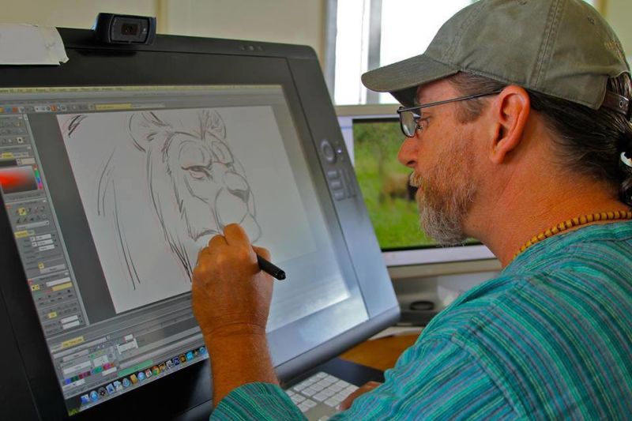
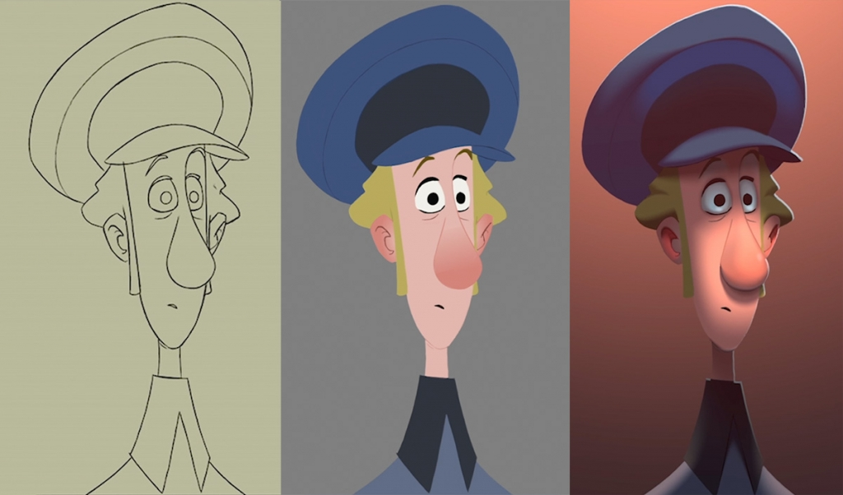



Slide 2


40 hrs

Slide 3
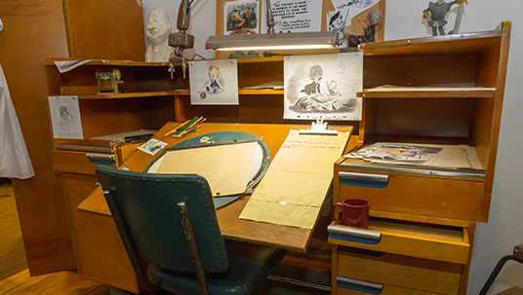
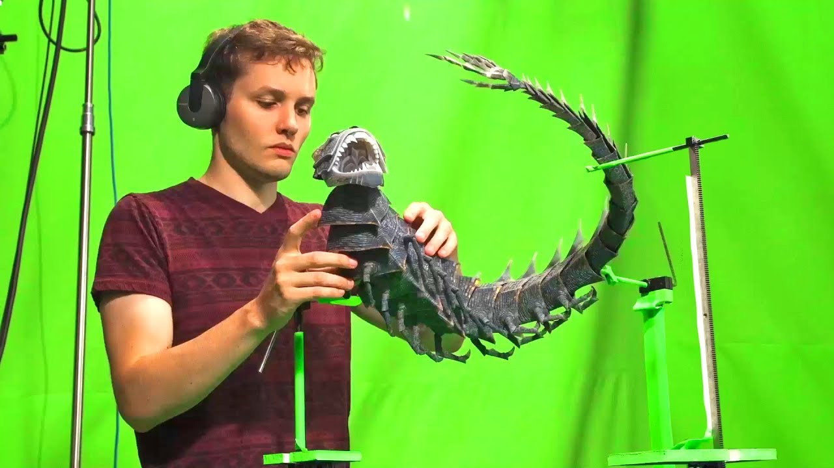
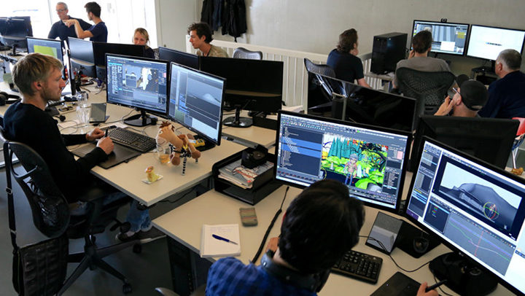

Slide 4

The average money made would be $63,000
Range anywhere between 49,000 -81,000

Slide 5

Degree needed
Typically a bachelors degree

Slide 6
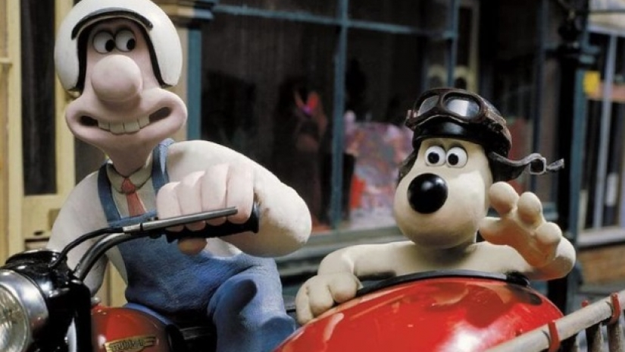
Glimpse into stop motion
https://youtu.be/FbDgl8haBAc

